Slide 1
The Beginning of World War I: Different Perspectives
Harvey
World History Honors
Fall 2013

Slide 2
Warm Up November 25th, 2013
Elaborate on the reasons for the United States’ entry into World War I.
Describe the event known for “triggering” World War I.
Recall from the readings and essay that was written in class. In your opinion, should the United States have chosen to remain neutral with the policy of isolationism?

Slide 3
Note taking strategy…up to you
Cornell notes
Old fashion, t-notes
Key topics on the left, notes on the right
Foldable
More creative, good for studying
You will need copy paper
Index cards
Best for quick studying
Key topic on the front, meat of the information on the back

Slide 4
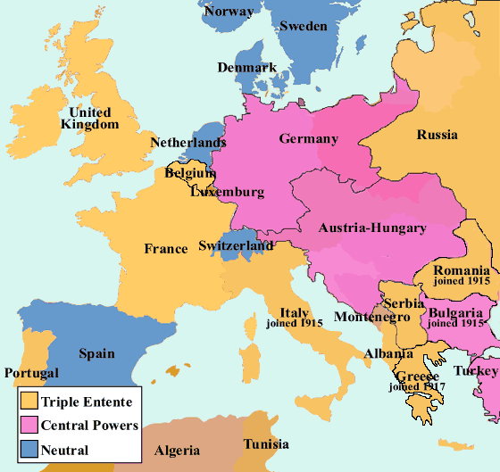
World War I: quick highlights and a recap
The Beginning
July 28th, 1914 Austria-Hungary declares war on Serbia
Most of Europe will become involved due to treaties that demand one country to protect another
West
Germany attacks
East
Russia attacks
South
Austria-Hungary attacks
Belgium
France
Germany
Austria-Hungary
Serbia

Slide 5
The Ottoman empire
1914 Germany tricks Russia
1915 the Triple Entente raids the Ottomans
Dardanelles
France and Great Britain attack
Gallipoli Peninsula
Britain invades
Mesopotamia
Britain invades the Turkish population

Slide 6
US In…Russia Out
April 1917, Central Powers and the Triple Entente were in a stalemate…the US enters the war due to attacks by Germans on US ships
November 1917
Russia pulls out
Russian Revolution-Bolshevik Revolution

Slide 7
Trench Warfare
1916-1917 top method of fighting in the East and West
Fight from dug-in positions
Used heavy artillery, machine guns, and chemical weapons
Millions of soldiers died…after reflection of this method, no side gained an advantage

Slide 8
The End
1918 both the Triple Entente and the Central Powers renewed offenses in efforts to win the war
Germany was weakening
Losing individual battles
Losing aggression
Influenza
Affected soldiers
Military begins to fall apart in the Central Powers
Armistice 1918
Central Powers seek peace agreements
Germany last to sign on November 11th, 1918
Austria-Hungary broken into several smaller countries
Treaty of Versailles
Germans responsible for the war
Had to repay the debts of the war
Reduction in weapons
Lost territory

Slide 9
World War I: The Perspectives
Unites States: Recap
War explodes in Europe, under President Woodrow Wilson the US remains neutral
US becomes economic and industrial powerhouse due to the demands Europe needs for wartime
Public opinion split due to immigration
Lusitania sinks
German U-Boats were sinking US vessels heading for Great Britain wasting cargo and killing civilians
Zimmerman telegram intercepted
Germany to create alliance with Mexico…Mexico’s dream of taking back territory in the US captured in the Mexican War.
1917 Congress approves declaration of War

Slide 10
World War I: From the other Countries…
June 28th, 1914 Archduke of Austria Fran Ferdinand and wife shot by Serbian Gavrilo Princip
Assassination furthered tensions between Austria-Hungary and Serbia
Austria-Hungary want to invade Serbia but then there’s Russia
Russia has close ethnic and political ties to Serbians
Russia’s army not well organize, but large and capable of being a huge threat
Austria-Hungary turns to Germany
July 5th, 1914 Austria-Hungary to meet with Kaiser Wilhelm II about the concern of Russia
The Blank Check
Kaiser didn’t fell Russia would respond with military
Cousins with Tsar Nicholas II-hoped for diplomacy
However, if Russian troops were sent to invade, Germany agrees to help aid them in war

Slide 11
Austria-Hungary’s Ultimatum
July 23rd, 1914 ultimatum issued to Serbia of ten demands
Austria-Hungary was to be apart of the archduke’s assassination investigation
Take part in judicial process against suspects
Eliminate all anti-Austrian activism and propaganda in the country
Written by the Austrian Counsel of Ministers
Meant to be humiliating to the Serbians
July 25th Serbia accepts some of the ultimatum
July 28th Austria declared war on Serbia
July 29th shells fall on Serbian capital Belgrade

Slide 12
The Rest enter
July 30th Russia mobilizes troops
Germany feels this is Russia declaring war, so they prepare their troops
Failed communication and diplomatic efforts by Great Britain send Germany to declare war on Russia on August 1st
August 3rd Germany declares war on France in accordance with the Schlieffen Plan
In order to reach France’s least protected border, Germans would pass through neutral Belgium
Britain had a defense treaty with Belgium which leads to declaration of war on August 4th

Slide 13
War motives
Germany
Little interest in the Austria/Serbian feud, but concerned with neighbors
Russia more involved with European affairs
Modernizing and expanding military
War may have been inevitable so fight them while they’re weak
Felt Britain and France would disregard the treaties and remain neutral, so military leaders convinced themselves they could win
British
Held title of the largest naval fleet in the world
Had the most colonies (world power)
Germany decides to offer competition by trying to match the naval fleet and gain new colonies
GB power was feeling threatened so tried diplomacy, but Germany ignored…Great Britain will be looking for a chance at war

Slide 14
War Motives
French
1871 France lost Alsace and Lorraine to Germany
Humiliated and desperate to regain land
Feared a larger German invasion
Hoped for war with Russia for distraction in order to regain their territory
Russian
A little unclear
Pre WWI
Time of greatest instability
Tsar didn’t have complete control or power (fragile)
Military was unorganized and not well trained

Slide 15
Next Class…
Be prepared for a quiz
We will then look at the Opening Moves of WWI
Germany’s attack on Belgium
Russia’s attack on Germany
Battle of Tennenberg
Austria-Hungary’s losses
And more

Slide 16
For the rest of class…
WWI Motives and Vocabulary Bingo
Map of Europe 1914 Point and Click (iPad Lab)
Complete vocabulary (list of 20)
Create flashcards on Quizlit.com (yes it is free)
There’s a way to compete with classmates once you create them hopefully we can figure it out.

