Slide 1
Imperialism
Harvey Fall 2014 World History

Slide 2
Warm Up November 13th, 2014
Which of the following statements do you most agree with?
A stronger country has the right to take over a weaker country.
A strong country should never interfere with weaker countries.
A strong country should use its strength to help weaker countries.
A strong country should use its strength to gain the most economic advantages possible from weaker countries.
Notes:
Regardless of how you voted, in this era we will look at how strong countries built empires by taking over weaker countries.

Slide 3
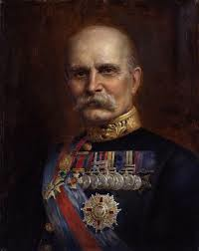
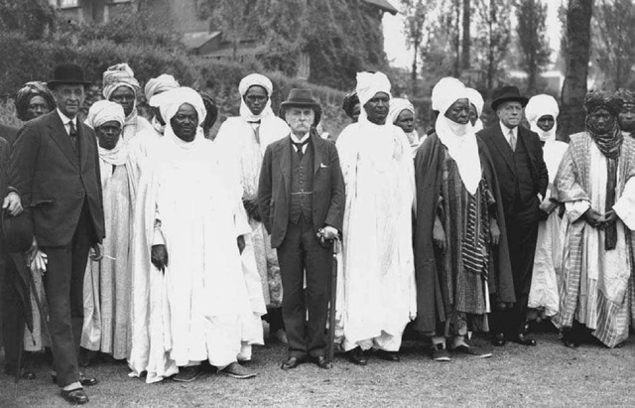
Lord Frederick Lugard
“There are some who say we have no right to Africa at all, that ‘it belongs to the natives.’ I hold that our right is the necessity that is upon us to provide for our ever-growing population-either by opening new fields for emigration, or by providing work and employment…and to stimulate trade by finding new markets.”

Slide 4
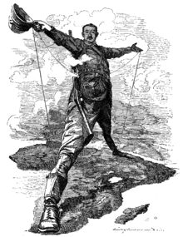
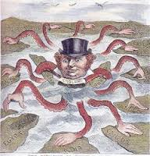
Objectives
Analyze the causes of the “new imperialism”
Explain why Western imperialism spread so rapidly
Describe how imperial governments ruled their empires.

Slide 5
Themes and Concepts
Imperialism
What factors led to the new imperialism of the 1800s?
Power
How did imperialistic countries gain power over the peoples of Africa and Asia?
Change
What were the effects of imperialism?
Nationalism
How did imperialism lead to nationalistic feelings in China and other nations of Asia and Africa?

Slide 6
Tennessee State Standards
W.14 Cite strong and thorough textual evidence to support analysis of the causes of 19th century European imperialism, the role of Social Darwinism, the desire for increased political power, and the search for natural resources and new markets as prelude to the Berlin Conference. (C, E, G, H, P)
W.20 Explain the transfer in 1858 of government to Great Britain on the Indian Subcontinent following the Sepoy Rebellion. (G, H, P)

Slide 7
Imperialism
A country’s dominance of political, economic, and cultural life of another country
Similar to colonization
Where have you heard this before?

Slide 8
Old Imperialism
1500-1800
Europeans focused on Americas, India, Southeast Asia, and the coasts of West Africa and China
God, Glory, and Gold
Roman Catholic movement
Lead by Portugal, Spain, Netherlands, and Britain
Calmed due to Napoleonic Wars, Industrial Revolution, and nationalism

Slide 9
New Imperialism
1870-1914
Nationalism & rise of nation-states
Economies booming from Industrial Revolution
Focused on Asia and Africa
More Protestant movement
Lead by Great Britain followed by US, France, Germany, Belgium, Italy and Russia

Slide 10
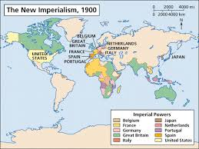
How Imperialism Divided the World

Slide 11
Revival of Imperialism
It went away once, why the glorious return?

Slide 12
Causes of NEW Imperialism
Economy | Politics and Military | Society | Science and Invention
Need for natural resources Needed new markets Place for growing populations to settle Places to invest the profits | Bases for trade and navy ships Power and security of global empire Spirit of nationalism | Wish to spread Christianity “Westernize” the natives Believed the western ways were better=paternal | New weapons New medicines Improved ships

Slide 13
Effect of Nationalism
Nationalism is a cause for new imperialism
Promoted the idea of national superiority
“that’s right I’m better than you”
Imperialist believed they had the RIGHT to take control of countries they felt were weaker
Apply the theory of Darwinism
“survival of the fittest”
A competition where the weak would be dominated by the strong
https://www.youtube.com/watch?v=URfF6Wtyc_0

Slide 14
Imperialist? Supremist? Racist? All 3?
Rudyard Kipling
The White Man’s Burden
“moral duty to educate people in nations lesser developed”
Missionaries will take the lead in spreading western ideas, customs, and religion
http://public.wsu.edu/~brians/world_civ/worldcivreader/world_civ_reader_2/kipling.html

Slide 15
Rapid Expansion
1870-1914
Weak Non-Western States
Old civilizations declining
Ottoman Empire, Mughal India, Qing China
Africa
At war with neighbors
Damaged by slave trade

Slide 16
Western Advantage
Strong economies
Well organized governments
Military muscles
Technology
Boats
Telegraphs
Quinine
Maxim machine gun
http://www.youtube.com/watch?v=LV5f2nmgpQk

Slide 17
Types of Rule
Direct Rule
French
Sent French officials to impose culture, westernize, and create little “frenchies”
Indirect Rule
British
Appointed local leaders
Encouraged native children to attend western schools
Sphere of Influence
Claim rights to trade and territory from a distance
Occurs in China

Slide 18
India
Mughal empire once strong and large
1700s declines due to lack of leadership
Great Britain’s East India Trading Company will take over
1800s will control 3/5s of India

Slide 19
East India Trading Company takes advantage of the diversity
Keep the natives angry, confused, and divided
Westernize the population
Main concern make $$$
Did improve roads, safety, and preserve peace
Will introduce school, law, customs, religion, and language

Slide 20
Sepoy Rebellion
1850 EIC makes bad moves
Requires sepoys to serve everywhere
Upper class Hindus cannot travel for religious reasons
Allows Hindu women to remarry
Against religion again
Armored with new guns
1857 new guns with bite off cartridge for powder
Greased with pig and cow fat
Again against religion

Slide 21
1857 Indians will unite and rebel against their British officials
https://www.youtube.com/watch?v=MV0fYMIvtyU

Slide 22
Sepoy Rebellion

